Slide 1
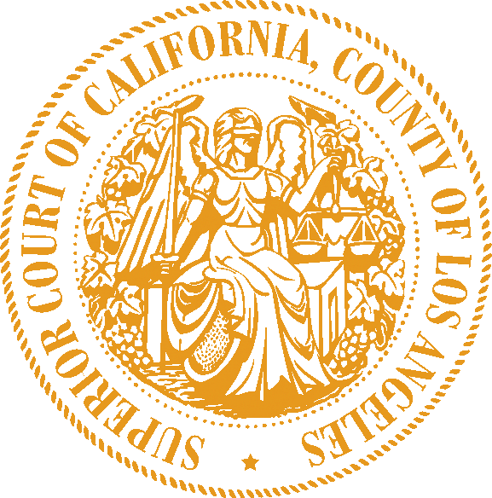
Superior Court of California | County of Los Angeles
Civil mediation VENDOR resource list
MEDIATION SERVICES FOR CIVIL CASES
to settle their active civil case before trial reduced-cost or free (for selected cases) mediation with attorney mediators or retired judges the option of mediation in person or by phone or videoconference These organizations If all parties agree to mediation, you may contact these organizations to request a “RESOURCE LIST MEDIATION.” For more information and FAQs about the Civil Mediation Vendor Resource List, visit www.lacourt.org/ADR.Res.List NOTE: This service is only available for a limited number of selected active civil cases. It may not be available for your case. It is NOT available for small claims, civil harassments, family law or probate. DISCLAIMER: The Los Angeles County Superior Court provides this list as a public service. The Court does not endorse, recommend, or make any warranty as to the qualifications or competency of any provider on this list. Inclusion on this list is based on the representations of the provider. The Court assumes no responsibility or liability of any kind for any act or omission of any provider on this list. 01.30.2023
IF ALL PARTIES WANT…
THESE ORGANIZATIONS MAY BE ABLE TO HELP
ADR Services, Inc.
Janet Solis
Assistant Case Manager
janet@adrservices.com
213-683-1600
MCLA
Myer Sankary, Esq.
Program Director Wendee Berman
Program Manager Devin Tucker Program Administrator
info@mediationLA.org
833-476-9145

